Slide 1
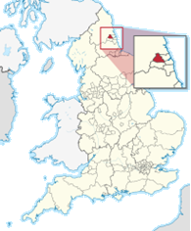
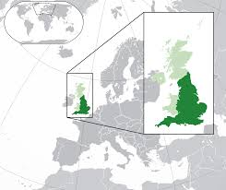

Mobility citizenship in the United Kingdom Colonialism, Europeanisation and de-Europeanisation
Presented at Osaka University, Japan
16 July 2024

Slide 2
dfbjs

Slide 3
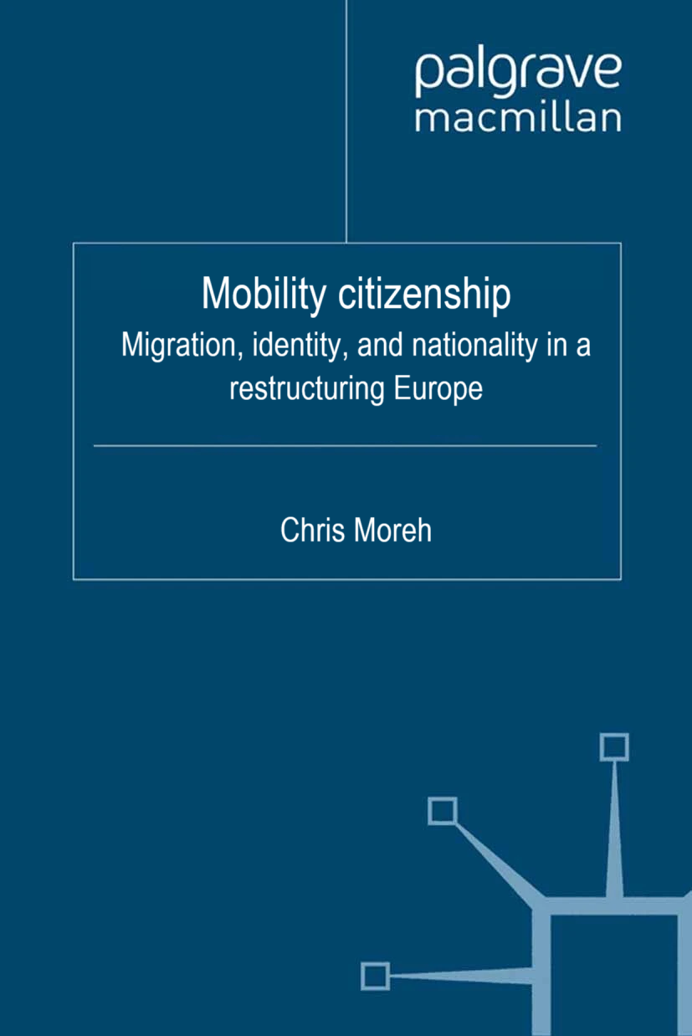

Chapter 1. Introduction: the constellationist imagination
Chapter 2. Transnational citizenship constellations
2.1. Postcolonial constellations: nationality and citizenship in Britain
2.2. Supranational constellations: citizenship of the European Union
2.3. Extraterritorial constellations: external ethnic citizenship in Hungary and Romania
Chapter 3. European mobility constellations
3.1. The EU: from guest work to free movement
3.2. Central Eastern Europe: from ‘migration potential’ to ‘Eurostardom’
3.3. The UK: from Windrush to Brexit
Chapter 4. Open borders and free movement: experiencing and evaluating mobility citizenship
4.1. The ‘freedom’ business: navigating digital migration infrastructures
4.2. Free movement: the Hungarian experience
4.3. Open borders: the Romanian experience
4.4. EU citizenship: opportunity or constraint?
Chapter 5. The moral political economy of extraterritorial citizenship
5.1. Closed borders and unfree movement
5.2. External naturalisation: numbers and procedures
5.3. Mobility citizenship and ethno-national identity
Chapter 6. Citizenship in transit: patterns and narratives of naturalisation in Britain
6.1. Patterns of naturalisation before and after Brexit
6.2. Citizenship narratives before Brexit
6.3. Brexit citizenship: rights, anxieties and belonging
6.4. Passport citizenship: settled in mobility?
Chapter 7. Conclusions: mobility citizenship constellations

Slide 4
Chapter 1. Introduction: the constellationist imagination
Chapter 2. Transnational citizenship constellations
2.1. Postcolonial constellations: nationality and citizenship in Britain
2.2. Supranational constellations: citizenship of the European Union
2.3. Extraterritorial constellations: external ethnic citizenship in Hungary and Romania
Chapter 3. European mobility constellations
3.1. The EU: from guest work to free movement
3.2. Central Eastern Europe: from ‘migration potential’ to ‘Eurostardom’
3.3. The UK: from Windrush to Brexit
Chapter 4. Open borders and free movement: experiencing and evaluating mobility citizenship
4.1. The ‘freedom’ business: navigating digital migration infrastructures
4.2. Free movement: the Hungarian experience
4.3. Open borders: the Romanian experience
4.4. EU citizenship: opportunity or constraint?
Chapter 5. The moral political economy of extraterritorial citizenship
5.1. Closed borders and unfree movement
5.2. External naturalisation: numbers and procedures
5.3. Mobility citizenship and ethno-national identity
Chapter 6. Citizenship in transit: patterns and narratives of naturalisation in Britain
6.1. Patterns of naturalisation before and after Brexit
6.2. Citizenship narratives before Brexit
6.3. Brexit citizenship: rights, anxieties and belonging
6.4. Passport citizenship: settled in mobility?
Chapter 7. Conclusions: mobility citizenship constellations

Slide 5
Outline

Slide 6
Mobility
Citizenship
Notes:
There is a deeply ingrained conceptual tension between citizenship as a legal status and bundle of identities associated with spatially and temporally defined socio-legal categories, and geographical mobility as a force that works against these categorisations and moorings. The paradox of this tension is that both citizenship and mobility have simultaneously expanded their social significance and ubiquity during the past three decades, both empirically – as the combined effect of globally increasing numbers of international migrants (de Haas, Castles, and Miller, 2020) and the increasing acceptance of dual citizenship worldwide (Vink et al., 2019) – and in terms of academic interest ­– as shown by the institutionalisation and flourishing of research fields and approaches such as ‘citizenship studies’ (Turner, 1997) and ‘mobilities studies’ (Hannam, Sheller, and Urry, 2006). This is due precisely to the various ways in which mobility and citizenship have been seen to interconnect and redefine each other.

Slide 7

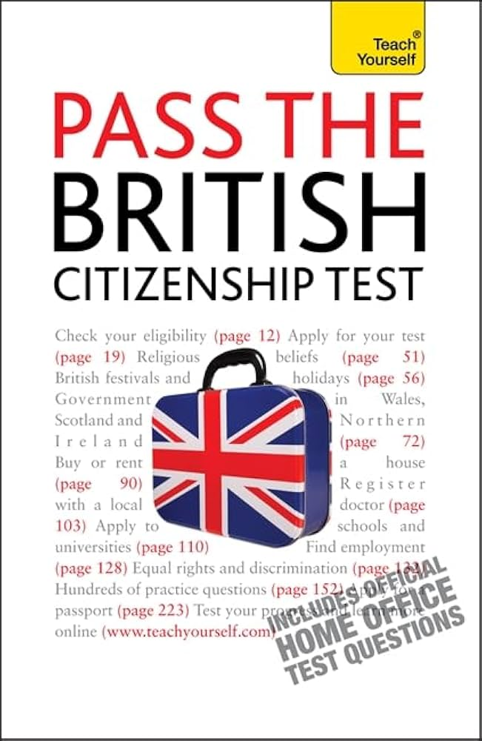


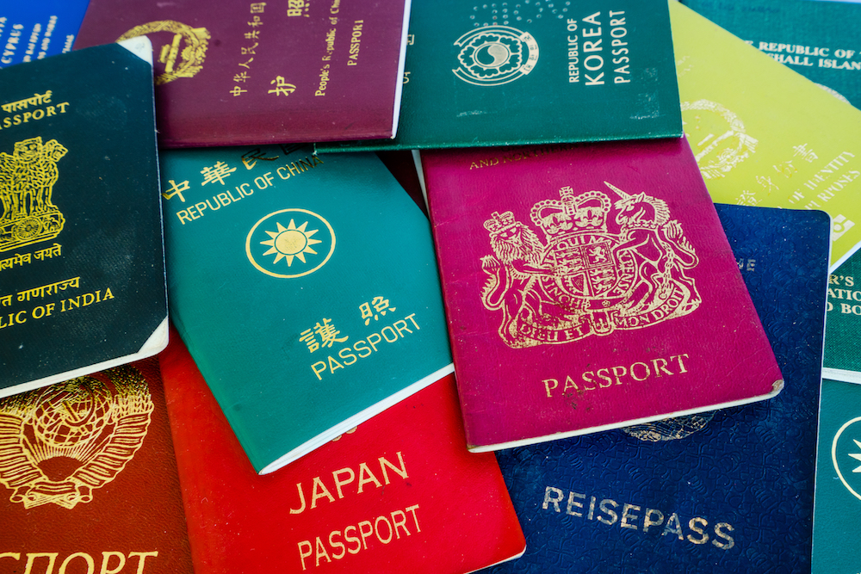
Citizenship
“Citizenship: a remarkable case of sudden interest” (Heater 1991)
Encouraging citizenship: report of the Commission on Citizenship (UK) (1990)
Citizenship as social closure: “Every state claims to be the state of, and for, a particular, bounded citizenry, usually conceived as a nation” (Brubaker, 1992)
Citizenship as participation;
public vs. private + active vs. passive; globalization and “global political responsibilities” (Turner 1992)
Citizenship as activity: acts, actions, activism, performativity, “new” citizenship(s)
(Isin 1997; Isin 2002; Isin and Nielsen 2008; Isin 2012; Isin 2019)
Citizenship studies (Isin 1997; Turner 1997; Isin and Turner 2002)
Notes:
Brubaker 1992: “Every state claims to be the state of, and for, a particular, bounded citizenry, usually conceived as a nation”
- The lasting strength of Brubaker’s analysis lies in the deep socio-historical contextualisation of contemporary citizenship, which he sees as shaped by long traditions and ideologies of nationhood. By tying apparently legalistic concepts to rich histories of nation-building, Brubaker has also shown that ‘citizenship is not simply a legal formula; it is an increasingly salient social and cultural fact’ (Brubaker, 1992: 23), and as such of central importance for sociological investigation.
Turner 1992: a sociological model of citizenship along two axes: (1) public and private definitions of moral activity in terms of the creation of a public space of political activity, and (2) active and passive forms of citizenship in terms of whether the citizen is conceptualized as merely a subject of an absolute authority or as an active political agent.
“Following the work of Barrington Moore (1966), the different routes towards modern polities have distinctive consequences for the character of citizenship” (Turner 1992: 56) – both Turner and Brubaker build on the Moorian tradition.

Slide 8
Citizenship
Global comparative datasets:
GLOBALCIT Citizenship Law Dataset (Vink et al. 2023);
MACIMIDE Global Expatriate Dual Citizenship Dataset (Vink, De Groot, and Luk 2020);
MIPEX Migrant Integration Policy Index (Solano and Huddleston 2020);
MPI Multiculturalism Policy Index for Immigrants and Minorities (Banting and Kymlicka 2020; Wallace, Tolley, and Vonk 2021; Westlake 2021)
Citizenship as process:
naturalisation (Yang 1994)
civic integration (Joppke 2007; Joppke 2017; Goodman 2012; Bartram 2018; Bassel, Monforte, and Khan 2021)
Notes:
Another development building on the comparative tradition has been the development – as of late – of larger-scale comparative datasets. still focused primarily on “Western” European and Anglophone countries, but increasingly global in ambitions and coverage.

Slide 9
Mobility
Citizenship
Notes:
There is a deeply ingrained conceptual tension between citizenship as a legal status and bundle of identities associated with spatially and temporally defined socio-legal categories, and geographical mobility as a force that works against these categorisations and moorings. The paradox of this tension is that both citizenship and mobility have simultaneously expanded their social significance and ubiquity during the past three decades, both empirically – as the combined effect of globally increasing numbers of international migrants (de Haas, Castles, and Miller, 2020) and the increasing acceptance of dual citizenship worldwide (Vink et al., 2019) – and in terms of academic interest ­– as shown by the institutionalisation and flourishing of research fields and approaches such as ‘citizenship studies’ (Turner, 1997) and ‘mobilities studies’ (Hannam, Sheller, and Urry, 2006). This is due precisely to the various ways in which mobility and citizenship have been seen to interconnect and redefine each other.

Slide 10
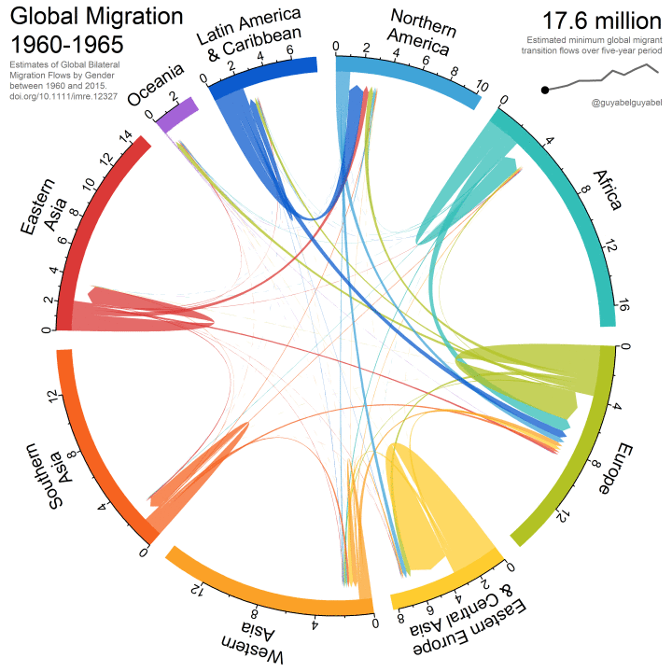
Mobility
Classical assimilationist paradigm:
immigration → assimilation
Transnationalism paradigm:
Nations Unbound (Basch, Glick Schiller, and Szanton Blanc 1994)
networks and transnational social fields; from ‘below’ (Glick Schiller, Basch, and Blanc-Szanton, 1992, 1995; Wimmer and Glick Schiller, 2002)
‘New mobilities paradigm’:
no rigid and stable structures, but flows of people, objects and information in incessant motion, loosely pinned together by ‘rhizomic attachments’ or ‘moorings’ (Urry 2000; Urry 2007; Hannam, Sheller, and Urry, 2006; Adey, 2010; Cresswell, 2006)
a ‘wanton destruction of empirical methods’ (Favell, 2001: 392)
Data and code:
Abel (2018)
Notes:
For the bilateral migration data visualisation using chord diagrams, see:
Abel, Guy. 2018. “R Code for Animated Chord Diagrams.” Guyabel.Com. https://guyabel.com/post/animated-directional-chord-diagrams/.
Abel, Guy J., and Joel E. Cohen. 2019. “Bilateral International Migration Flow Estimates for 200 Countries.” Scientific Data 6 (1). Nature Publishing Group: 82. doi:10.1038/s41597-019-0089-3.

Slide 11
Mobility
Political transnationalism:
migrants’ “increasing opportunities to combine external and internal status and affiliations” (Bauböck, 2003)
“institutional change as a result of migration flows” → citizenship constellations (Bauböck 2010)
Migration infrastructures:
opportunity/constrains structure shaping peoples’ capability to migrate (Preiss, 2022; Düvell and Preiss, 2022)
crucial meso-level elements that shape migration decision-making in the context of various ‘aspirations’ and ‘capabilities’ (de Haas, 2021; Czaika, Bijak, and Prike, 2021)
The European Union as mobility-citizenship opportunity structure
Data and code:
Abel (2018)
Notes:
For the bilateral migration data visualisation using chord diagrams, see:
Abel, Guy. 2018. “R Code for Animated Chord Diagrams.” Guyabel.Com. https://guyabel.com/post/animated-directional-chord-diagrams/.
Abel, Guy J., and Joel E. Cohen. 2019. “Bilateral International Migration Flow Estimates for 200 Countries.” Scientific Data 6 (1). Nature Publishing Group: 82. doi:10.1038/s41597-019-0089-3.

Slide 12


Citizenship and mobility in the UK and the EU

Slide 13
Citizenship in the United Kingdom
Calvin v. Smith
(‘Case of the Postnati’)
Craw v. Ramsey
Naturalization Act of 1844
Naturalization Act of 1870
1608
1844
…
1870
1847
1670
ius soli
(“law of the soil”)
British subjecthood - allegiance to the monarch (primarily) by virtue of birth within the realm of the Crown.
Naturalisation first formalised;
Before: personal grant through an Act of Parliament; more limited rights than birthright subjecthood;
After: handled by government officials; equal rights to British subjects by birth
Amendment allowing colonial legislatures to implement own naturalisation rules;
‘imperial naturalisation’: those naturalised in the UK
vs.
‘local naturalisation’: those naturalised in a colony
Precedent: 1670 ‘Craw v. Ramsey’
Allowed renunciation and loss of birthright British subjecthood;
Precedent: 1868 United States Expatriation Act made it possible for naturalised citizens to formally divest themselves of their birthright nationality
‘Prenati’ Scots naturalised by Irish Parliament in 1635: not English subjects;
Ireland subordinate in law to England ➔ local decisions = local rights
Notes:
- This conception was rooted in pre-modern feudal principles that bound one to the land on which they lived through personal loyalty to the landowning nobleman or church, and was formalised through a 1608 ruling in the legal case of Calvin v. Smith – also known as the ‘Case of the Postnati’ or simply ‘Calvin’s Case’ – concerning whether someone born in Scotland after the ‘union of the crowns’ of 1603, when King James became the ruler of both Scotland and England, should be considered a subject in England. The ruling established that a person born within any territory held by the King of England owed allegiance to the Kind and should be considered his subject. The case provided judicial backing to the common law principle of ius soli (“law of the soil”) and proved immensely consequential for what was to become Britain’s imperial subjecthood (see Price, 1997).
British Empire nascent only in early 1600s; 1707 Union with Scotland; Plantation of Ulster (1609-1622) and political union with the Kingdom of Ireland only in 1800. Virginia (US) became the first Crown Colony in 1624, the East India Company first foothold on the Indian subcontinent in 1611 and nationalised by the British Crown in 1858.
- ‘imperial naturalisation’: subjects naturalised in the United Kingdom who enjoyed subject status throughout the Empire
vs.
‘local naturalisation’: those naturalised in a colony who enjoyed subject status only under that colonial administration
- Precedent: Scots born before 1603 (so still foreigners in England following Calvin’s Case) who moved to Ireland and were collectively naturalised by the Irish Parliament in 1635 should not be considered English subjects because Ireland was subordinate in law to England and therefore decisions taken by its local parliament have only local authority

Slide 14

Citizenship in the United Kingdom
British Nationality and Status of Aliens Act
British Nationality Act 1948
British Nationality Act 1981
1914
1948
1981
HMT Empire Windrush
Commonwealth Immigrants Acts
1968 1971
1965 1968 1976
Compromise between uniform subjecthood rights across the Empire and the diverging local conditions affecting the UK and Dominions
Established Citizenship of the United Kingdom and Colonies to complement the citizenships offered by the other Dominions;
‘through citizenship of a country—and through citizenship alone—will a person become a British subject’ (HC Deb, 7 July 1948, col. 388);
“British subject” = “Commonwealth citizen”
Precedent: 1946 Canadian Citizenship Law
Race Relations Acts
Defined ‘British citizenship’ for the first time as a legal status for those with direct links to the United Kingdom;
Removed the transnational ideal of a universal subjecthood;
replaced automatic ius soli with a mixed principle of birthright citizenship requiring at least one parent to be citizen or ‘settled’
1973:
UK EEC accession
Notes:
- 1914 Act: enshrined in the letter of the law the common practice of considering as a ‘natural-born British subject’ anyone, or a descendant in the male line of someone, ‘born within His Majesty's dominions and allegiance’, with some few exceptions. It further set our criteria for the ‘imperial naturalisation’ of foreigners, however, that part of the Act would only apply in the Dominions if they chose to adopt it in their own legislatures. The Act also explicitly specified that it should not affect any laws already in force in the Dominions, ‘or prevent any such Legislature or Government from treating differently different classes of British subjects’ (British Nationality and Status of Aliens Act 1914, 7 August 1914, 26(1)). This included ‘the power of exclusion of British subjects if of a particular colour or a particular race’ (Imperial Conference, 1911: 254; see also fn. 11 below).
The compromise arrangements of the 1914 Act achieved little if anything in the way of reaffirming the indivisibility of British imperial subjecthood, or at any rate it fell well short of UK Home Secretary Winston Churchill’s interpretation of the endeavour as one ‘of securing a uniform and world-wide status of British citizenship which shall protect the holder of that certificate wherever he may be’ (Imperial Conference, 1911: 256). Its shortcomings, however, were not a great concern to Britain for several reasons.
1948: The main reason why the concept of ‘citizenship’ had to be introduced at all was not any careful jurisprudential deliberation or committed reformist intent, but ‘[b]ecause the Dominions are insisting that we shall not be in a different position (…), or what might be thought to be in a superior position, from them. They say, “We are going to create citizens. You create citizens. And then the sum total of all citizens, so created will be British subjects.”’ (HL Deb, 11 May 1948, col. 785). The Act introduced two significant novelties. On the one hand, it established the status of ‘citizenship of the United Kingdom and Colonies’ to complement the citizenships being offered by the other Dominions; on the other hand, sensitive to the fact that not everyone in the Dominions care to define themselves as either ‘British’ or ‘subject’, it stipulated that ‘the expression “British subject” and the expression “Commonwealth citizen” shall have the same meaning’ in the present as well as any other past or future Act of Parliament (British Nationality Act 1948, 30 July 1948, 1(2)). These two new additions to the legal vocabulary highlight that the concept of citizenship emerging in British law for the first time was still weakly defined and transitory in character.
HMT Empire Windrush – the ship that had all the potential to become a symbol of victory over Nazi atrocities but instead became the symbol of post-war immigration – docked at Tilbury with its five-hundred or so Caribbean migrants on 21 June 1948 whilst the British Nationality Bill was still undergoing its second reading in Parliament. While it was not unnoticed without some concern by parliamentarians and the government, the incident did not leave its print on the debates over the Bill. Potential migration from the colonies was discussed mainly hypothetically in connection to concerns that citizens of the Dominions may end up with fewer rights if they were to resettle in the UK compared to colonial subjects who would already be local citizens of the ‘United Kingdom and Colonies’ upon arrival.
over the next decade almost half a million ‘citizens of the United Kingdom and Colonies’ settled in the UK

Slide 15
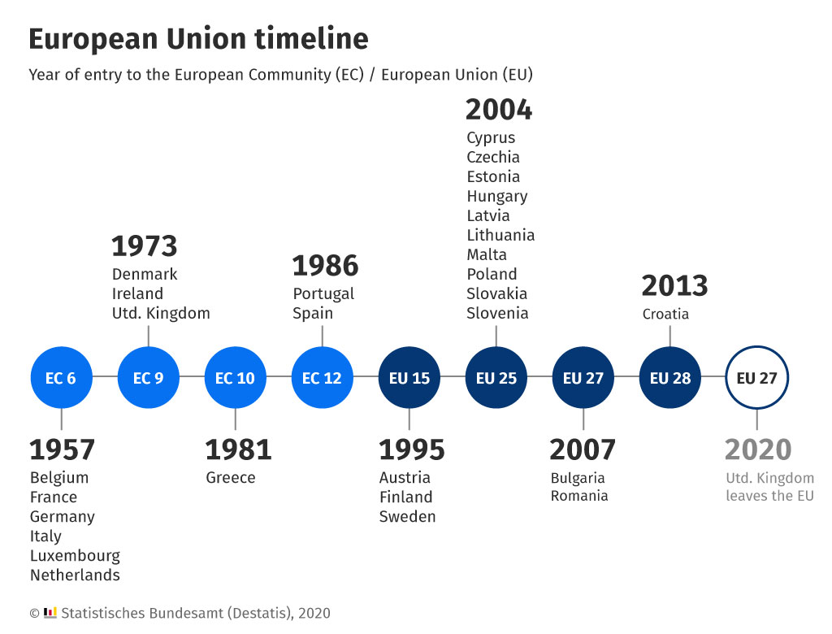

EU citizenship
November 1993
Maastricht Treaty (TEU)
EU membership referendum

Slide 16
EU citizenship
November 1993
Maastricht Treaty (TEU)
EU membership referendum

Slide 17
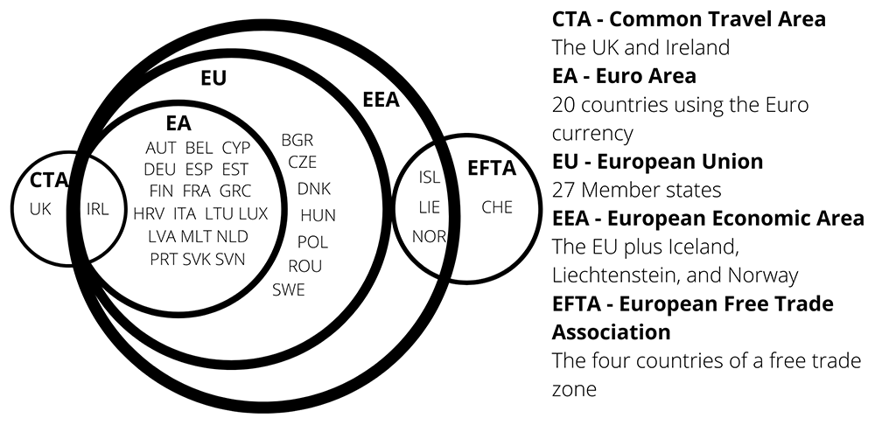
Source: Barker 2024
Mobility citizenship in the UK

Slide 18
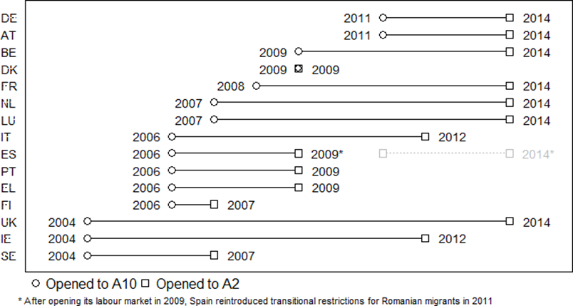
The EU’s eastward enlargement
Labour-market liberalisation for A8 and A2 nationals in EU countries
Source: Author’s elaboration.
Data and code: https://osf.io/uav8b/

Slide 19
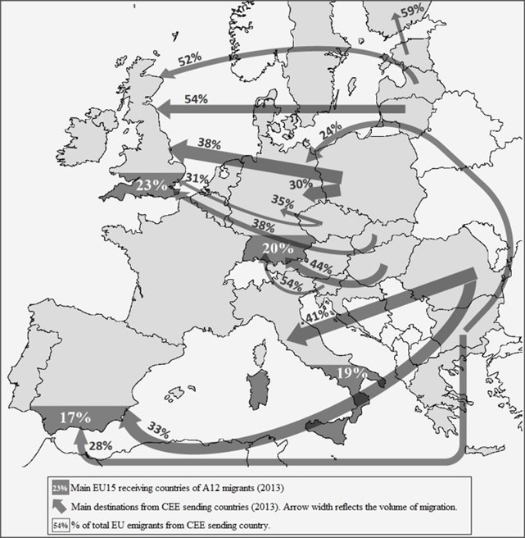
The EU’s eastward enlargement
Distribution of A12 migrants in EU countries in 2013
Notes: Where the difference between the first and second destination country is less than 15%, both destinations are included.
Source: Eurostat (2024); missing values were filled with the nearest available data from Eurostat or: France census 2008 and 2010 (INSEE, 2008, 2011); UK census 2011 (Office for National Statistics et al., 2017); Greece census 2011 (El.Stat, 2011).

Slide 20
Mobility-citizenship transitions in the UK

Slide 21
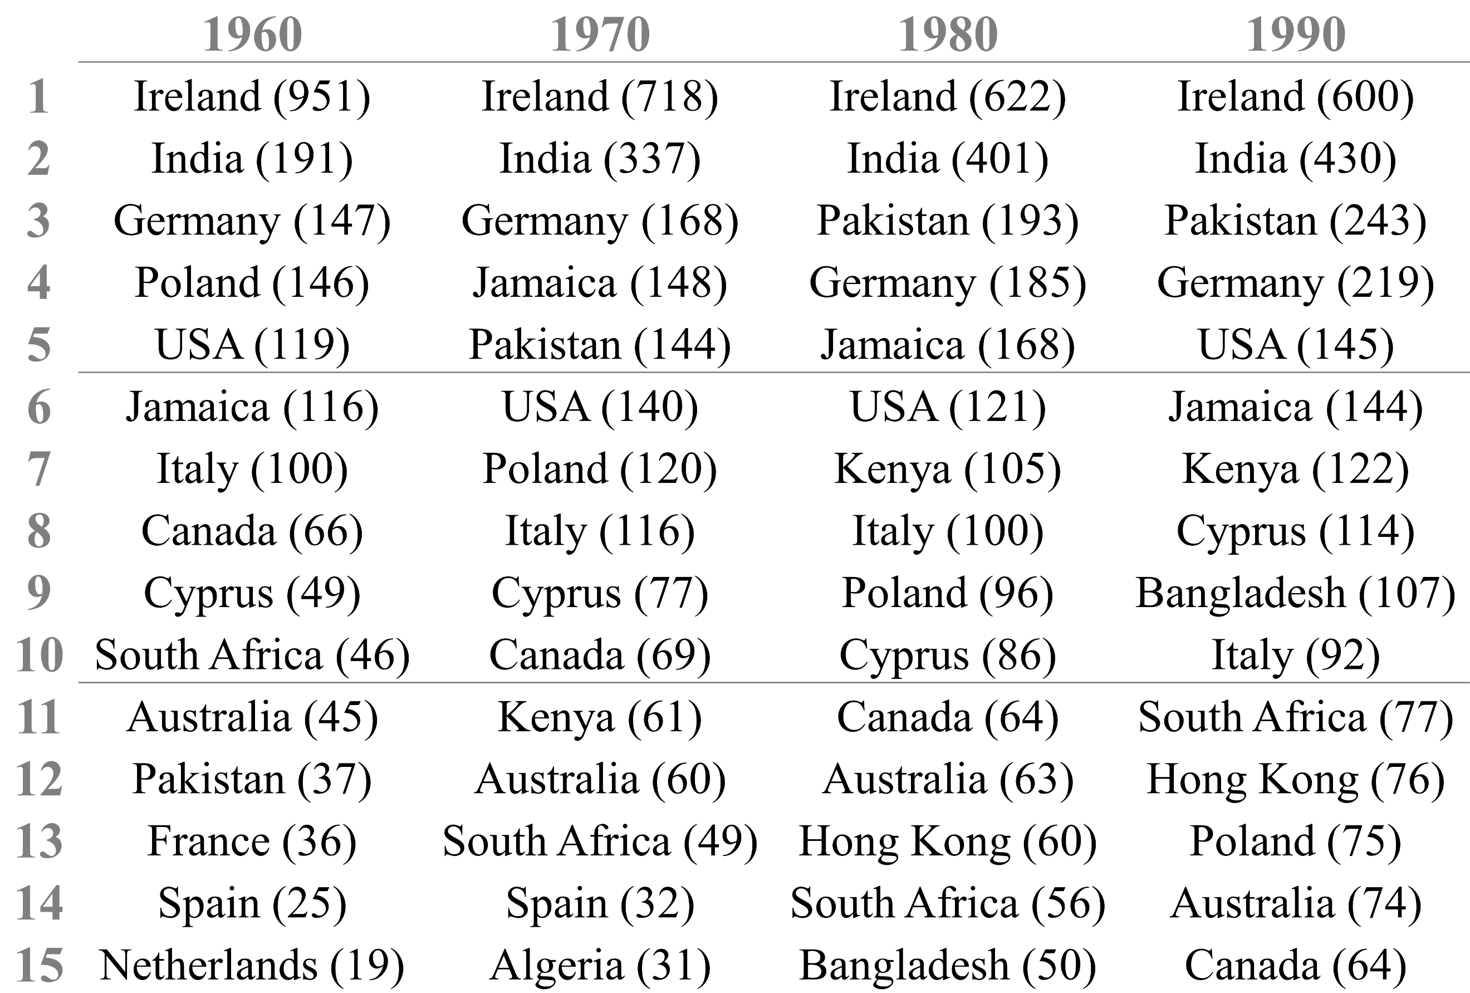
The post-colonial migration system
Top fifteen non-UK-born nationality groups in the United Kingdom (1960–1990)
Notes: Numbers in parentheses represent rounded population size in thousands.
Source: Author’s elaboration based on data from the World Bank (2011).

Slide 22
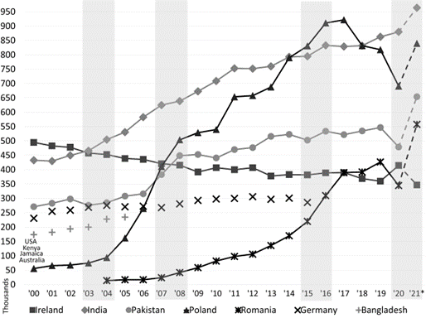
The post-2004-EU-enlargement transition
The top five countries of birth of non-UK born population in the United Kingdom (2000–2021)
Notes: * Data for 2021 is from the 2021 Census, as measured on 21st March 2021.
Source: Author’s elaboration based on data from the Annual Population Survey (Office for National Statistics, 2021) and Census 2021 and Census 2021 (Office for National Statistics, 2023a, 2023c; National Records of Scotland, 2024; Northern Ireland Statistics and Research Agency, 2022a, 2022b).

Slide 23
The post-2004-EU-enlargement transition
Foreign-born and foreign-citizen residents in the United Kingdom, by EU/non-EU status (2004–2021)
Notes: * Data for 2021 is from the 2021 Census, as measured on 21st March 2021. Data on previous years are estimates from the Annual Population Survey. The APS data series on ‘Population by Country of Birth and Nationality’ was discontinued after June 2021 to update its methodology considering the Census data.
Source: Author’s elaboration based on data from the Annual Population Survey (Office for National Statistics, 2021) and Census 2021 (Office for National Statistics, 2023b, 2023d; National Records of Scotland, 2024; Northern Ireland Statistics and Research Agency, 2022a, 2022b).

Slide 24
The post-Brexit transition
EU Settlement Scheme applications (2018 –2024)
Notes: EEA/EFTA/CH includes Iceland, Liechtenstein, Norway and Switzerland.
Source: Author’s elaboration based on data from the Home Office (2024)

Slide 25
Naturalisation before and after “Brexit”
UK citizenship applications by EU nationality group (2004-2024)
Notes: Includes both naturalisation applications and registrations as a British citizen.
Source: Author’s elaboration based on data from Home Office (2024).

Slide 26
Naturalisation before and after “Brexit”
Comparison of UK citizenship applications by EU/non-EU nationality group (2004-2024)
Notes: Includes both naturalisation applications and registrations as British citizen
Source: Author’s elaboration based on data from Home Office (2024).

Slide 27
Naturalisation motivations and the meaning of citizenship

Slide 28
Naturalisation motivations
Yang (1994): cost-benefit model of subjective utility maximization
benefits: political and socio-economic rights and privileges
costs: money and effort; potential loss of the former citizenship
For EU citizens, the perceived benefits of naturalization in their member state of residence are lower
A ‘return of assimilation’ (Brubaker 2003); a ‘revaluation’ of citizenship via strengthening ‘civic integration’ requirements (Goodman 2010; Joppke 2007; Joppke and Morawska 2003)
‘[e]njoyment of permanent residence by Union citizens who have chosen to settle long term in the host Member State would strengthen the feeling of Union citizenship and is a key element in promoting social cohesion, which is one of the fundamental objectives of the Union’ … ‘Union citizens who have resided legally for a continuous period of five years in the host Member State shall have the right of permanent residence there’ (EU Citizenship Directive [2004/38/EC])
‘shall have the right of’ understood as automatically obtaining permanent resident status without any declaration of intention or an application procedure, although a certifying document must be issued by Member states upon request by a qualifying person ‘as soon as possible’ and ‘free of charge or for a charge not exceeding that imposed on nationals for the issuing of similar documents’
‘legal integration’: Permanent Residence Certificate (PRC) - regulated by EU law - or naturalisation as British citizens → A return of citizenship? (Moreh, McGhee, and Vlachantoni 2020)

Slide 29
EU citizens’ naturalisation patterns before “Brexit”
Correlation between NINo allocations (2002-2010) and citizenship applications (2008-2016)
Source: Own calculations based on data from the Department for Work and Pensions (2017) and Home Office (2017a).
Notes: year-paired by six-year lapses; years-pairs should be read as follows: 02/08 refers to NINo allocations in 2002 and British citizenship applications in 2008.

Slide 30
The “Brexit effect” on naturalisation intentions
Predicted probability of naturalisation, January-June 2016
Notes: Values show the predicted probability of intention to apply for British citizenship at any time in the future for each level of the explanatory variables, with 95% confidence intervals. Probabilities are drawn from six different logistic regression models that include each explanatory variable separately. All models include controls for: sex; age (quadratic); parental status; time in UK; and the employment status of the economic unit.
The sample size is 1,307 across all models.
Source: Author’s elaboration based on data from the EUinUK 2016 survey
Notes:
- The ‘migration reasons’ predictor was a composite measurement derived using a Principal Components Analysis (PCA) run on seven items in a question bloc that measured respondents’ reasons for moving to the UK instead of another EU country. The items were: (1) Higher wages, (2) Better business opportunities, (3) More jobs available, (4) Better schooling for your children, (5) Better medical care, (6) More political/civic freedom, and (7) Better social benefits. The individual items were measured on a scale of 1 (not at all important) to 5 (very important), with an additional option of ‘Not true of UK,’ which was recoded as 1 (not at all important) for the PCA analysis. Conceptually, items 1–3 were conceived to denote economic reasons, items 4 and 9 educational reasons, and items 5–8 and 10 reflect social, political and personal motivations. Two components were extracted and retained, with social-political reasons loading strongly on the first component and economic-career reasons having high loadings on the second. For further analyses, a scale of 0 to 16 was constructed summing the four constituent items of the ‘socio-political reasons’ component. A binary variable was created by coding scale scores of 12 or greater as ‘important’ and scores lower than 12 as ‘less important.’
- The effect of anxiety about the EU referendum: This measure was derived from yet another two survey questions: one about the perceived likelihood of a Brexit outcome in the EU Referendum, and another about the expected personal effects of a Brexit vote. Brexit anxiety, as used in the analysis, reflects the attitude of those who felt that there was at least ‘an equal probability’ of a vote in support of leaving the European Union, while at the same time considering that a possible Brexit would have a ‘very negative’ or ‘somewhat negative’ effect on their lives and the lives of their family members. 74% of the respondents in the sample considered that there was at least an equal likelihood that the referendum result would support the UK’s exit from the EU, with almost a quarter considering it ‘more’ or ‘very’ likely; probably a much higher proportion than what could have been recorded among professional political scientists at the time. For 70%, such an outcome would have had at least a ‘somewhat negative’ impact on their lives. All in all, 45% of the sample respondents felt ‘anxious’ about Brexit as defined above.

Slide 31
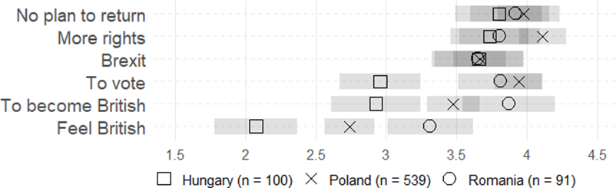
Naturalisation motivations
Reasons for planning naturalisation, January-June 2016
Notes: Values show marginal mean scores on six five-point Likert-type items measuring the perceived importance (1 = Not at all important, 5 = Very important) of stated reasons for planning to apply for British citizenship. 95% confidence intervals are shown.
The statements included are:
- ‘The possibility that the UK might leave the EU’ (Brexit),
- ‘I would have more rights even if the UK would not leave the EU’ (More rights),
- ‘I have no plan to return to my country of origin’ (No plan to return),
- ‘I feel British’ (Feel British),
- ‘I want to become British’ (To become British),
- ‘I want to vote in general elections’ (To vote).
The question was asked only of those who were planning to apply for citizenship in the future. Estimates are drawn from six linear regression models that control for: sex; age (quadratic); parental status; time in UK; and the employment status of the economic unit.
The model sample size is 730.
Source: Author’s elaboration based on data from the EUinUK 2016 survey.

Slide 32
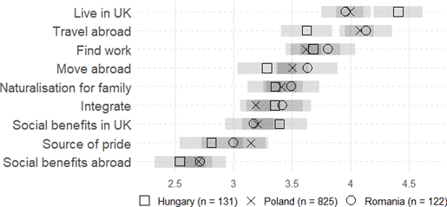
Citizenship perceptions
Perceptions about the advantages of British citizenship, January-June 2016
Notes: Values show marginal mean scores on nine five-point Likert-type items measuring agreement (1 = Strongly disagree, 5 = Strongly agree) with statements about the possible advantages of holding British citizenship. 95% confidence intervals are shown.
The statements included are:
- ‘It is easier to travel in the world with a British passport’ (Travel abroad),
- ‘It is easier to move to another (EU or non-EU) country as a British citizen’ (Move abroad),
- ‘It makes it easier to live in the UK for a longer period’ (Live in UK),
- ‘It is easier to find work as a British citizen’ (Find work),
- ‘It makes it easier to integrate into British society’ (Integrate),
- ‘It makes it easier to access social benefits in the UK’ (Social Benefits in UK),
- ‘It makes it easier to access social benefits in another (EU or non-EU) country’ (Social Benefits abroad),
- ‘It makes it easier for other family members to become British citizens’ (Naturalisation for family),
- ‘It is a source of pride’ (Source of pride).
The estimates are drawn from nine linear regression models that control for: sex; age (quadratic); parental status; time in UK; and the employment status of the economic unit.
The model sample size is 1,078.
Source: Author’s elaboration based on data from the EUinUK 2016 survey

Slide 34
Abel, Guy J. 2018. “R Code for Animated Chord Diagrams.” Personal Blog. https://guyabel.com/post/animated-directional-chord-diagrams/.
Abel, Guy J., and Joel E. Cohen. 2019. “Bilateral International Migration Flow Estimates for 200 Countries.” Scientific Data 6 (1). Nature Publishing Group: 82. doi:10.1038/s41597-019-0089-3.

Slide 35
References
Abel, Guy J. 2018. “R Code for Animated Chord Diagrams.” Personal Blog. https://guyabel.com/post/animated-directional-chord-diagrams/.
Abel, Guy J., and Joel E. Cohen. 2019. “Bilateral International Migration Flow Estimates for 200 Countries.” Scientific Data 6 (1). Nature Publishing Group: 82. doi:10.1038/s41597-019-0089-3.
Adey, Peter. 2010. Mobility. London and New York: Routledge.
Banting, Keith, and Will Kymlicka. 2020. “The Multiculturalism Policy Index (MPI).” https://www.queensu.ca/mcp/.
Barker, Emily. 2024. “A Timeline of Freedom of Movement in the European Economic Area [Version 3; Peer Review: 2 Approved, 1 Approved with Reservations].” Open Research Europe 2 (133). doi:10.12688/openreseurope.15042.3.
Bartram, David. 2018. “The UK Citizenship Process: Political Integration or Marginalization?” Sociology, December. SAGE PublicationsSage UK: London, England. doi:10.1177/0038038518813842.
Basch, Linda G., Nina Glick Schiller, and Cristina Szanton Blanc. 1994. Nations Unbound: Transnational Projects, Postcolonial Predicaments, and Deterritorialized Nation-States. S.l.: Gordon and Breach.
Bassel, Leah, Pierre Monforte, and Kamran Khan. 2021. “Becoming an Active Citizen: The UK Citizenship Test.” Ethnicities 21 (2). SAGE Publications: 311–332. doi:10.1177/1468796820966360.
Brubaker, Rogers. 1992. Citizenship and Nationhood in France and Germany. Cambridge, MA and London: Harvard University Press.
Cresswell, Tim. 2006. On the Move: Mobility in the Modern Western World. London: Routledge.
Czaika, Mathias, Jakub Bijak, and Toby Prike. 2021. “Migration Decision-Making and Its Key Dimensions.” The ANNALS of the American Academy of Political and Social Science 697 (1). SAGE Publications Inc: 15–31. doi:10.1177/00027162211052233.
de Haas, Hein. 2021. “A Theory of Migration: The Aspirations-Capabilities Framework.” Comparative Migration Studies 9 (1): 8. doi:10.1186/s40878-020-00210-4.
Düvell, Franck, and Carlotta Preiss. 2022. “Migration Infrastructures: How Do People Migrate?” In Introduction to Migration Studies: An Interactive Guide to the Literatures on Migration and Diversity, edited by Peter Scholten, 83–98. IMISCOE Research Series. Cham: Springer International Publishing. doi:10.1007/978-3-030-92377-8.
Favell, Adrian. 2001. “Migration, Mobility and Globaloney: Metaphors and Rhetoric in the Sociology of Globalization.” Global Networks 1 (4): 389–398.
Glick Schiller, Nina, Linda G. Basch, and Cristina Blanc-Szanton. 1992. “Transnationalism: A New Analytic Framework for Understanding Migration.” Annals of the New York Academy of Sciences 645 (1): 1–24. doi:10.1111/j.1749-6632.1992.tb33484.x.
Glick Schiller, Nina, Linda G. Basch, and Cristina Blanc-Szanton. 1995. “From Immigrant to Transmigrant: Theorizing Transnational Migration.” Anthropological Quarterly 68 (1): 48–63.
Goodman, Sara Wallace. 2012. “Fortifying Citizenship: Policy Strategies for Civic Integration in Western Europe.” World Politics 64 (4): 659–698. doi:10.1017/S0043887112000184.
Great Britain Commission on Citizenship. 1990. Encouraging Citizenship: Report of the Commission on Citizenship. London: HMSO. https://archive.org/details/encouragingcitiz0000grea.

Slide 36
References
Hannam, Kevin, Mimi Sheller, and John Urry. 2006. “Editorial: Mobilities, Immobilities and Moorings.” Mobilities 1 (1): 1–22. doi:10.1080/17450100500489189.
Heater, Derek. 1991. “Citizenship: A Remarkable Case of Sudden Interest.” Parliamentary Affairs 44 (2): 140–156.
Isin, Engin F. 1997. “Who Is the New Citizen? Towards a Genealogy.” Citizenship Studies 1 (1): 115–132. doi:10.1080/13621029708420650.
Isin, Engin F. 2002. Being Political: Genealogies of Citizenship. Minneapolis ; London: University of Minnesota Press.
Isin, Engin F. 2012. Citizens without Frontiers. New York, N.Y.: Continuum International.
Isin, Engin F. 2019. “Doing Rights with Things: The Art of Becoming Citizens.” In Performing Citizenship: Bodies, Agencies, Limitations, edited by Paula Hildebrandt, Kerstin Evert, Sibylle Peters, Mirjam Schaub, Kathrin Wildner, and Gesa Ziemer, 45–56. Cham: Springer International Publishing. doi:10.1007/978-3-319-97502-3_4.
Isin, Engin F., and Greg Marc Nielsen. 2008. Acts of Citizenship. London: Zed.
Isin, Engin F., and Bryan S. Turner. 2002. “Citizenship Studies: An Introduction.” In Handbook of Citizenship Studies, edited by Engin F. Isin and Bryan S. Turner, 1–10. London: Sage.
Joppke, Christian. 2007. “Beyond National Models: Civic Integration Policies for Immigrants in Western Europe.” West European Politics 30 (1): 1–22. doi:10.1080/01402380601019613.
Joppke, Christian. 2017. “Civic Integration in Western Europe: Three Debates.” West European Politics 40 (6): 1153–1176. doi:10.1080/01402382.2017.1303252.
Moreh, Chris, Derek McGhee, and Athina Vlachantoni. 2020. “The Return of Citizenship? An Empirical Assessment of Legal Integration in Times of Radical Sociolegal Transformation.” International Migration Review 54 (1). SAGE Publications Inc: 147–176. doi:10.1177/0197918318809924.
Preiss, Carlotta. 2022. “Digital Migration Infrastructures.” Ina Introduction to Migration Studies: An Interactive Guide to the Literatures on Migration and Diversity, edited by Peter Scholten, 99–110. IMISCOE Research Series. Cham: Springer International Publishing. doi:10.1007/978-3-030-92377-8.
Solano, Giacomo, and Thomas Huddleston. 2020. “MIPEX Migrant Integration Policy Index.” https://www.mipex.eu/.
Turner, Bryan. 1992. “Outline of a Theory of Citizenship.” In Dimensions of Radical Democracy : Pluralism, Citizenship, Community, edited by Chantal Mouffe, 33–62. London: Verso.
Turner, Bryan S. 1997. “Citizenship Studies: A General Theory.” Citizenship Studies 1 (1): 5–18. doi:10.1080/13621029708420644.
Urry, John. 2000. Sociology beyond Societies: Mobilities for the Twenty-First Century. London-New York: Routledge.
Urry, John. 2007. Mobilities. Cambridge: Polity.
Vink, Maarten, Gerard-Rene De Groot, and Ngo Chun Luk. 2020. “MACIMIDE Global Expatriate Dual Citizenship Dataset, v5.0.” Harvard Dataverse. doi:10.7910/DVN/TTMZ08.
Vink, Maarten Peter, Luuk Van Der Baaren, Rainer Bauböck, Jelena Dzankic, Iseult Honohan, and Bronwen Manby. 2023. “GLOBALCIT Citizenship Law Dataset, v2.0.” European University Institute. https://cadmus.eui.eu/handle/1814/73190.
Vink, Maarten, Arjan H Schakel, David Reichel, Ngo Chun Luk, and Gerard-René de Groot. 2019. “The International Diffusion of Expatriate Dual Citizenship.” Migration Studies 7 (3): 362–383. doi:10.1093/migration/mnz011.

Slide 37
References
Wallace, Rebecca, Erin Tolley, and Madison Vonk. 2021. Multiculturalism Policy Index: Immigrant Minority Policies. Third Edition. Kingston (ON), Canada: School of Policy Studies, Queen’s University at Kingston.
Westlake, Daniel. 2021. Annual Data for the Multiculturalism Policy Index for Immigrant Minorities, 1960-2020. Kingston (ON), Canada: School of Policy Studies, Queen’s University at Kingston.
Wimmer, Andreas, and Nina Glick Schiller. 2002. “Methodological Nationalism and beyond: Nation–State Building, Migration and the Social Sciences.” Global Networks 2 (4): 301–334. doi:10.1111/1471-0374.00043.
Yang, Philip Q. 1994. “Explaining Immigrant Naturalization.” International Migration Review 28 (3). SAGE PublicationsSage CA: Los Angeles, CA: 449–477. doi:10.1177/019791839402800302.

